Slide 1
Data Science using Jupyter Notebook
Dr. B. Santhosh Kumar
Sr. Asst. Professor
Dept. of Computer Science & Engg.,
GMR Institute of Technology,
Rajam-532127,
Andhra Pradesh
www.gmrit.org

Slide 7
Why we need Data Science

Slide 9
Data types
Structured Data
2 Dimensional-Rows & Columns
Homogeneous/Linear: Statistical Methods
Heterogeneous/ Non-Linear: Machine Learning
Unstructured Data
‘n’ Dimensional: Images, Text, Videos, Voice,….
Deep Learning (Neural Networks)

Slide 10
Data Science Paradigm

Slide 11
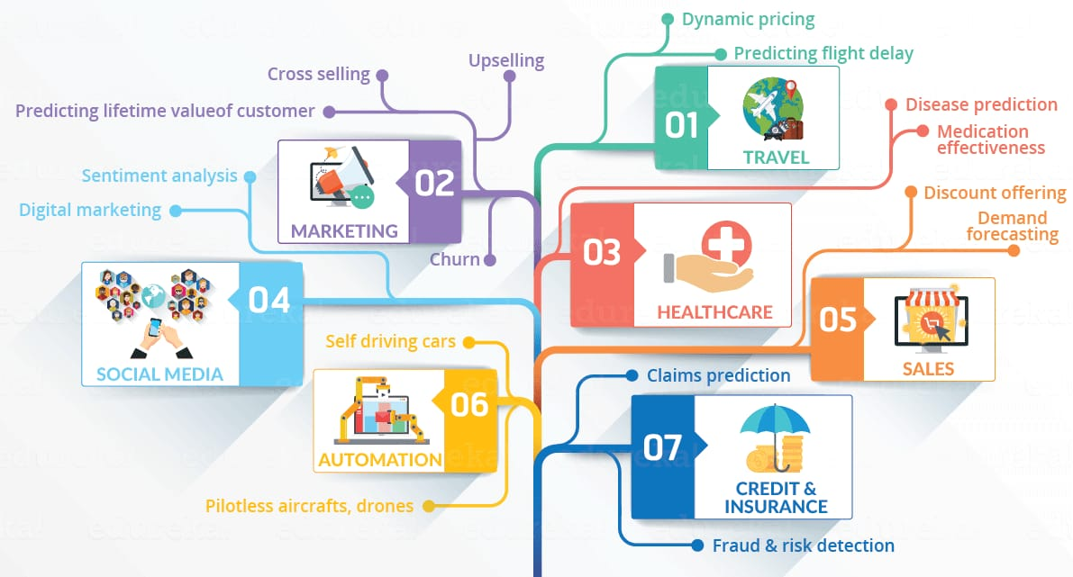

Slide 12
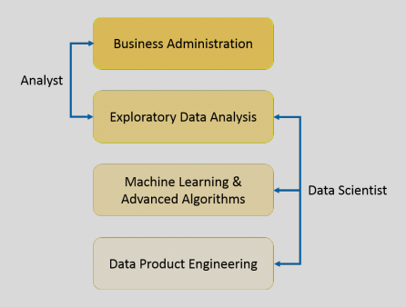
Introduction
It is a blend of various tools, algorithms, and Machine Learning principles with the goal to discover hidden patterns from the raw data.

Slide 14
Explanation Vs Prediction
Predictive Casual Analytics
Prescriptive Analysis
Machine learning for making predictions
Machine Learning for pattern discovery

Slide 16
Business Intelligence Vs Data Science
Features | Business Intelligence | Data Science
Data Source | Structured (Usually SQL, often Data Warehouse) | Both Structured and Unstructured (logs, cloud data, SQL, NoSQL,text)
Approach | Statistics Visualization | Statistics, Machine Learning, Graph Analysis, Neuro-Linguistic Programming(NLP)
Focus | Past and Present | Present and Future
Tools | Pentaho, Microsoft BI, Qlikview, R | Rapidminer, BigML, Weka, R

Slide 17
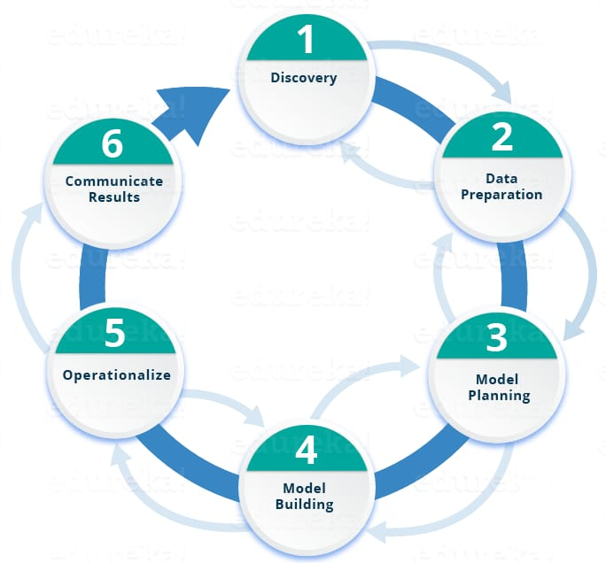
Life cycle of Data Science

Slide 21
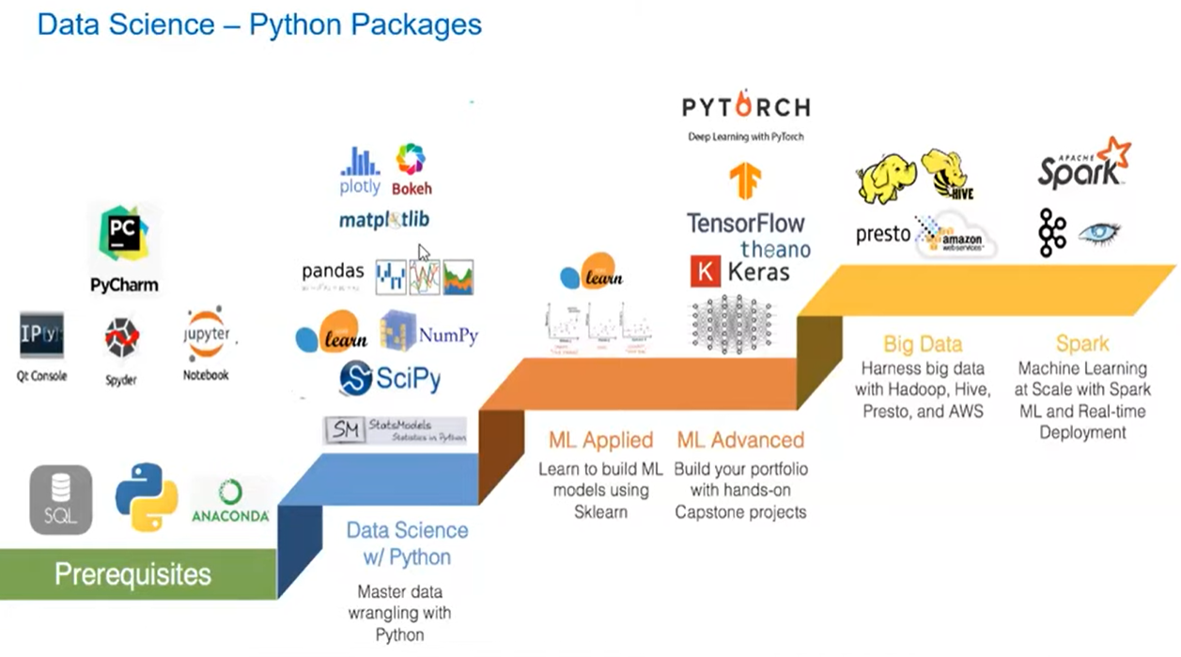

Slide 22
Tools of Data Science

Slide 23
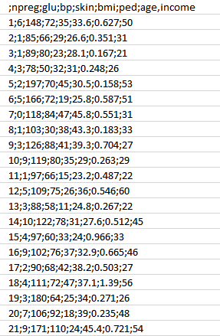
Case Study: Diabetes Prevention
Step 1: Collect the data based on the medical history of the patient
Attributes:
npreg – Number of times pregnant
glucose – Plasma glucose concentration
bp – Blood pressure
skin – Triceps skinfold thickness
bmi – Body mass index
ped – Diabetes pedigree function
age – Age
income – Income

Slide 24
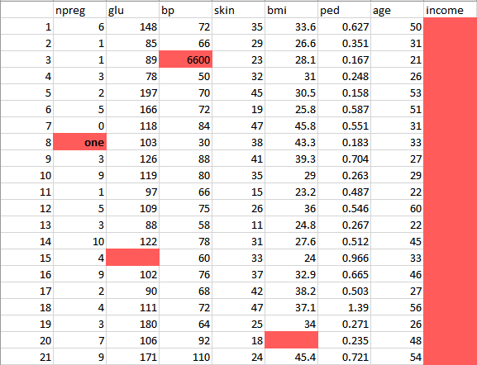
Case Study: Diabetes Prevention
Step 2: Clean and prepare the data for data analysis

Slide 25
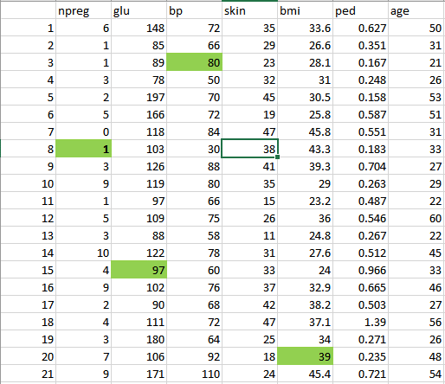
Case Study: Diabetes Prevention
Step 2: Clean and prepare the data for data analysis

Slide 26
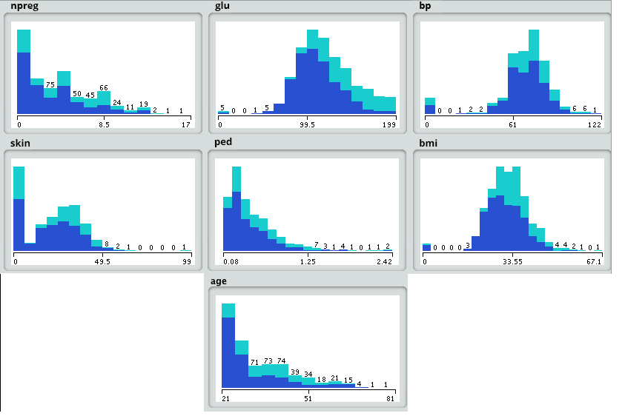
Case Study: Diabetes Prevention
Step 3: Analysis using Model planning

Slide 27
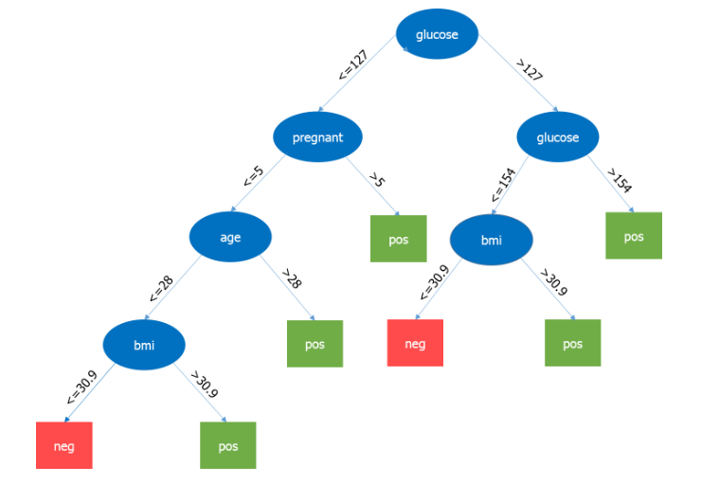
Case Study: Diabetes Prevention
Step 4: Model building-Decision Tree

Slide 28
Pros & Cons

Slide 29
Covid-19 Dataset
https://raw.githubusercontent.com/nytimes/covid-19-data/master/us-counties.csv
https://github.com/covid19india/covid19india-react
https://api.covid19india.org

Slide 30
Google co-lab
https://colab.research.google.com/notebooks/intro.ipynb#scrollTo=GJBs_flRovLc

Slide 31
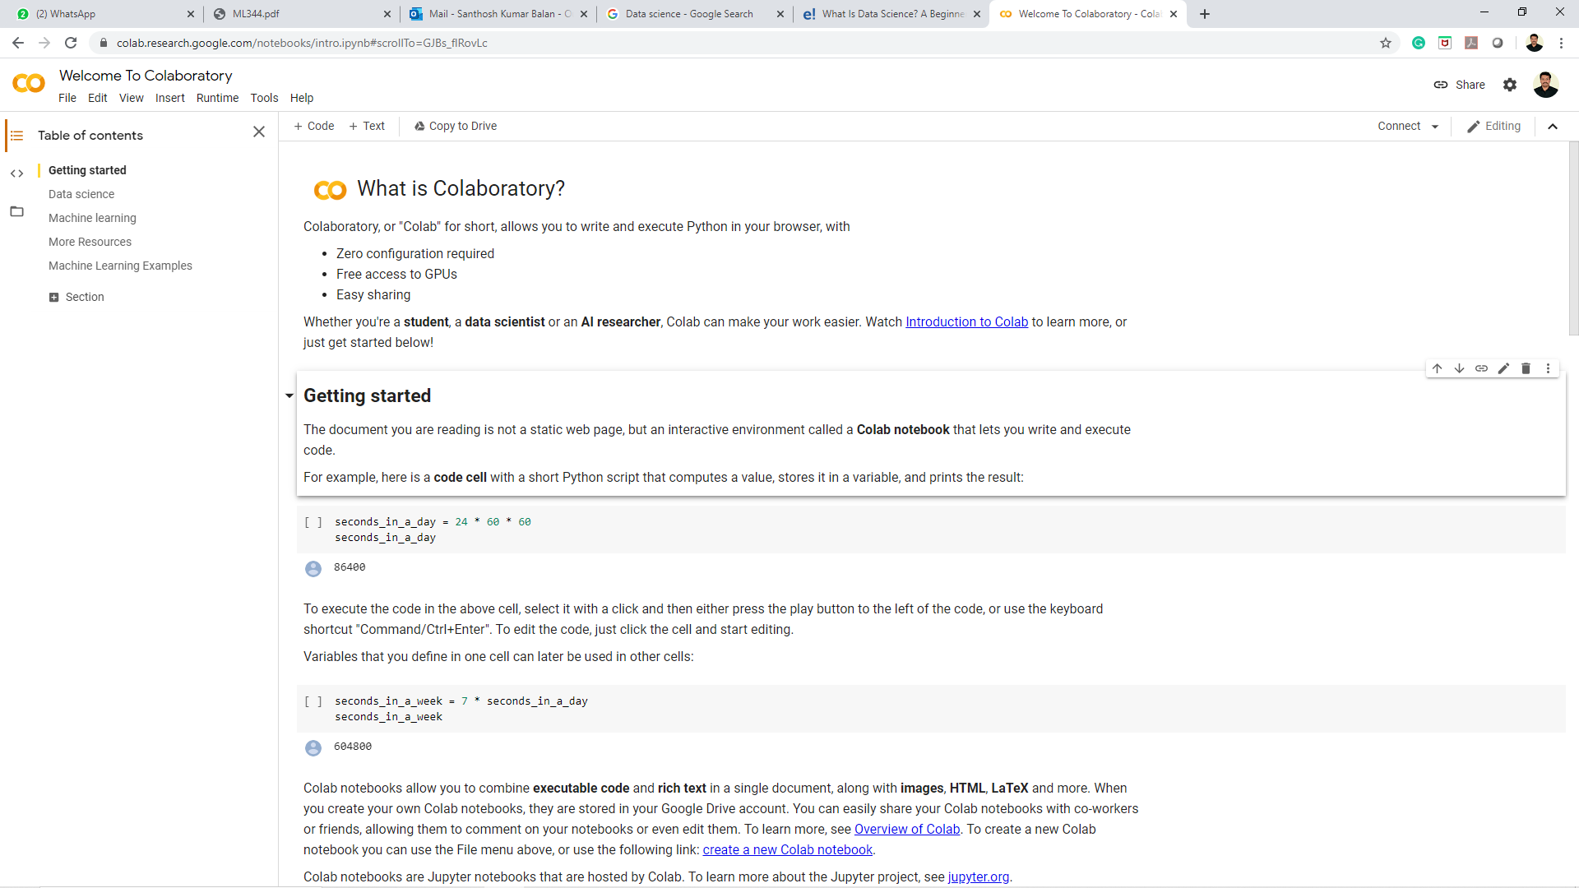
Google co-lab

Slide 32
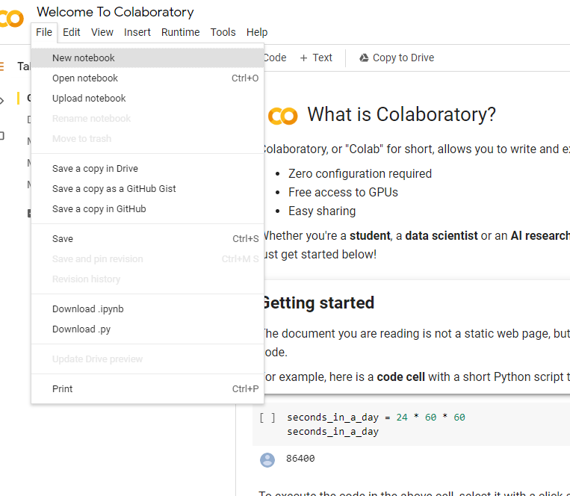
Google co-lab

Slide 33
My Details
Mail-id : Santhosh.b@gmrit.edu.in
b.santhoshkumar@gmail.com
Contact No : 9843622130
Website : http://sanan.weebly.com

