Slide 1
Data Science-Art of Life
Dr. B. Santhosh Kumar
Sr. Asst. Professor
Dept. of Computer Science & Engg.,
GMR Institute of Technology,
Rajam-532127,
Andhra Pradesh
www.gmrit.org

Slide 4
Why we need Data Science

Slide 5
Data types
Structured Data
2 Dimensional-Rows & Columns
Homogeneous/Linear: Statistical Methods
Heterogeneous/ Non-Linear: Machine Learning
Unstructured Data
‘n’ Dimensional: Images, Text, Videos, Voice,….
Deep Learning (Neural Networks)

Slide 6
Data Science Paradigm

Slide 7
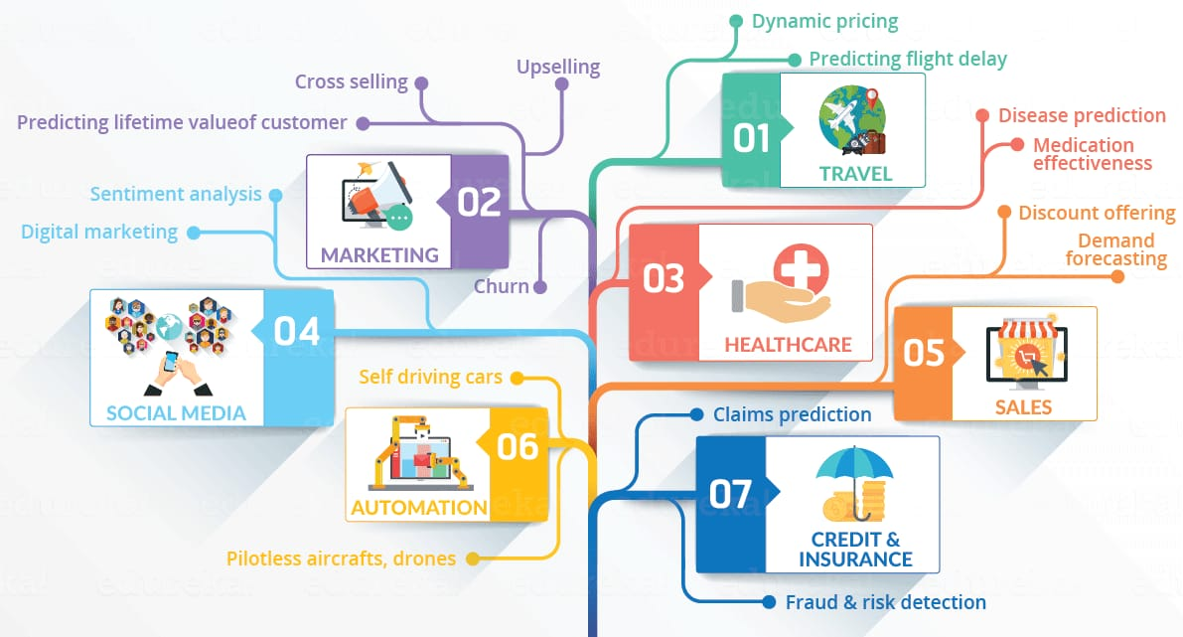

Slide 8
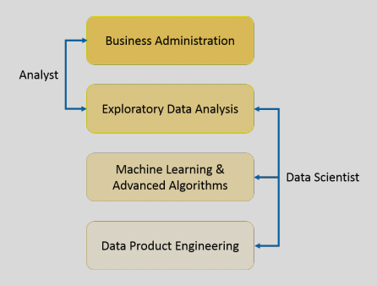
Introduction
It is a blend of various tools, algorithms, and Machine Learning principles with the goal to discover hidden patterns from the raw data.

Slide 10
Explanation Vs Prediction
Predictive Casual Analytics
Prescriptive Analysis
Machine learning for making predictions
Machine Learning for pattern discovery

Slide 12
Business Intelligence Vs Data Science
Features | Business Intelligence | Data Science
Data Source | Structured (Usually SQL, often Data Warehouse) | Both Structured and Unstructured (logs, cloud data, SQL, NoSQL,text)
Approach | Statistics Visualization | Statistics, Machine Learning, Graph Analysis, Neuro-Linguistic Programming(NLP)
Focus | Past and Present | Present and Future
Tools | Pentaho, Microsoft BI, Qlikview, R | Rapidminer, BigML, Weka, R

Slide 14
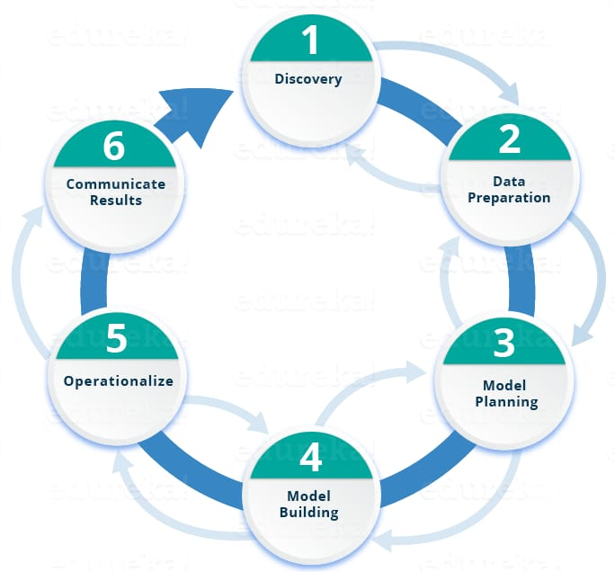
Life cycle of Data Science

Slide 15
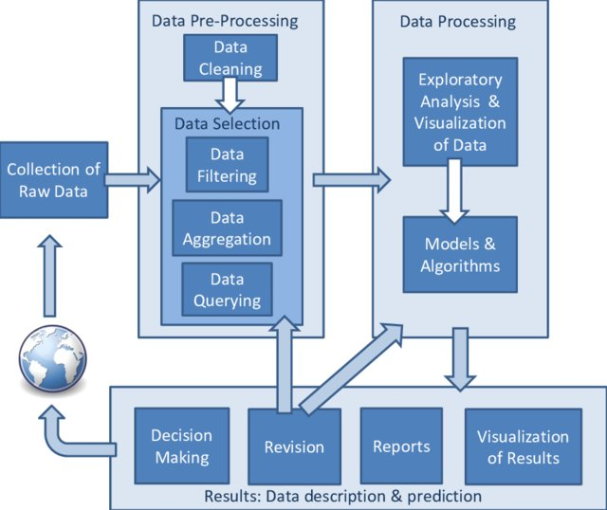
Life cycle of Data Science

Slide 16
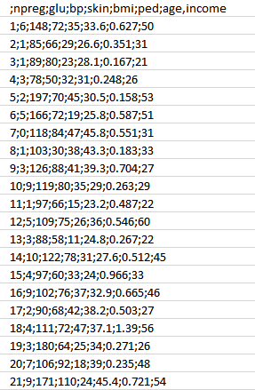
Case Study: Diabetes Prevention
Step 1: Collect the data based on the medical history of the patient
Attributes:
npreg – Number of times pregnant
glucose – Plasma glucose concentration
bp – Blood pressure
skin – Triceps skinfold thickness
bmi – Body mass index
ped – Diabetes pedigree function
age – Age
income – Income

Slide 17
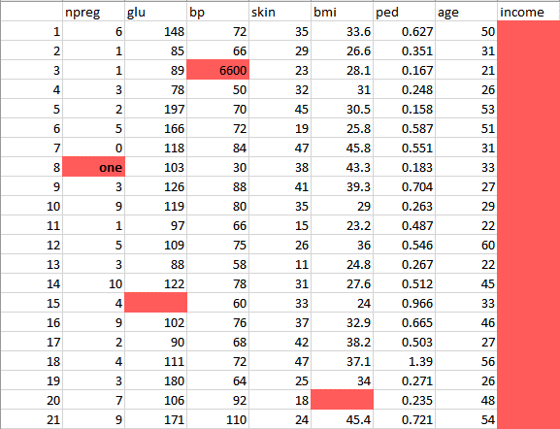
Case Study: Diabetes Prevention
Step 2: Clean and prepare the data for data analysis

Slide 18
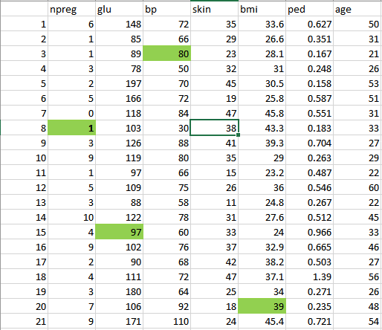
Case Study: Diabetes Prevention
Step 2: Clean and prepare the data for data analysis

Slide 19
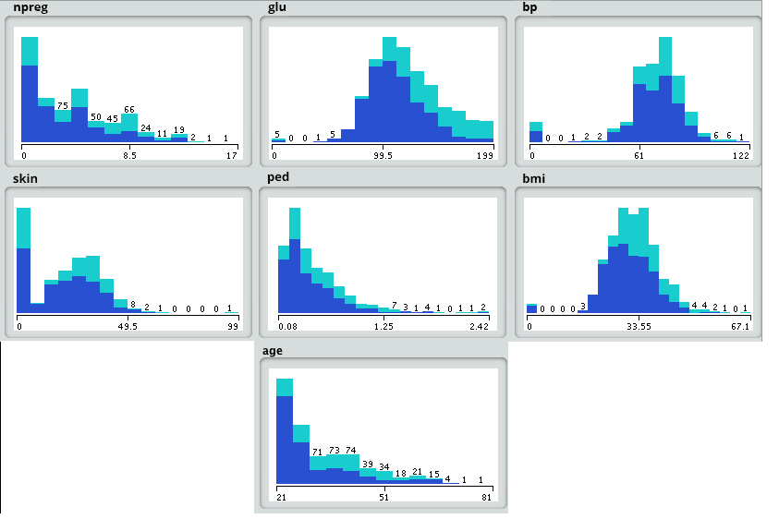
Case Study: Diabetes Prevention
Step 3: Analysis using Model planning

Slide 20
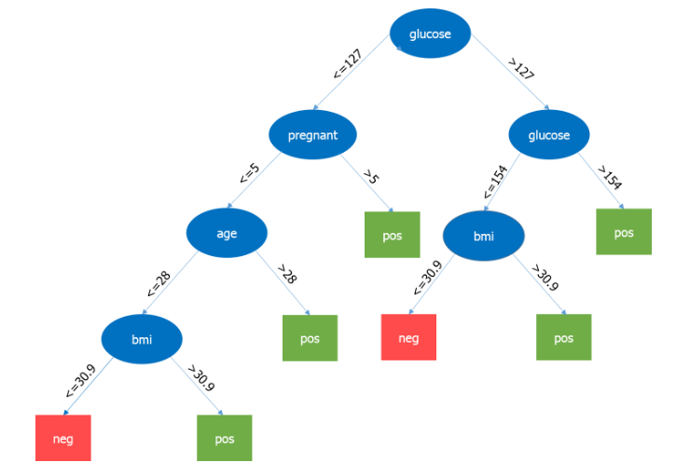
Case Study: Diabetes Prevention
Step 4: Model building-Decision Tree

Slide 21
Pros & Cons

Slide 22
Covid-19 Dataset
https://raw.githubusercontent.com/nytimes/covid-19-data/master/us-counties.csv
https://github.com/covid19india/covid19india-react
https://api.covid19india.org

Slide 23
Google co-lab
https://colab.research.google.com/notebooks/intro.ipynb#scrollTo=GJBs_flRovLc

Slide 24
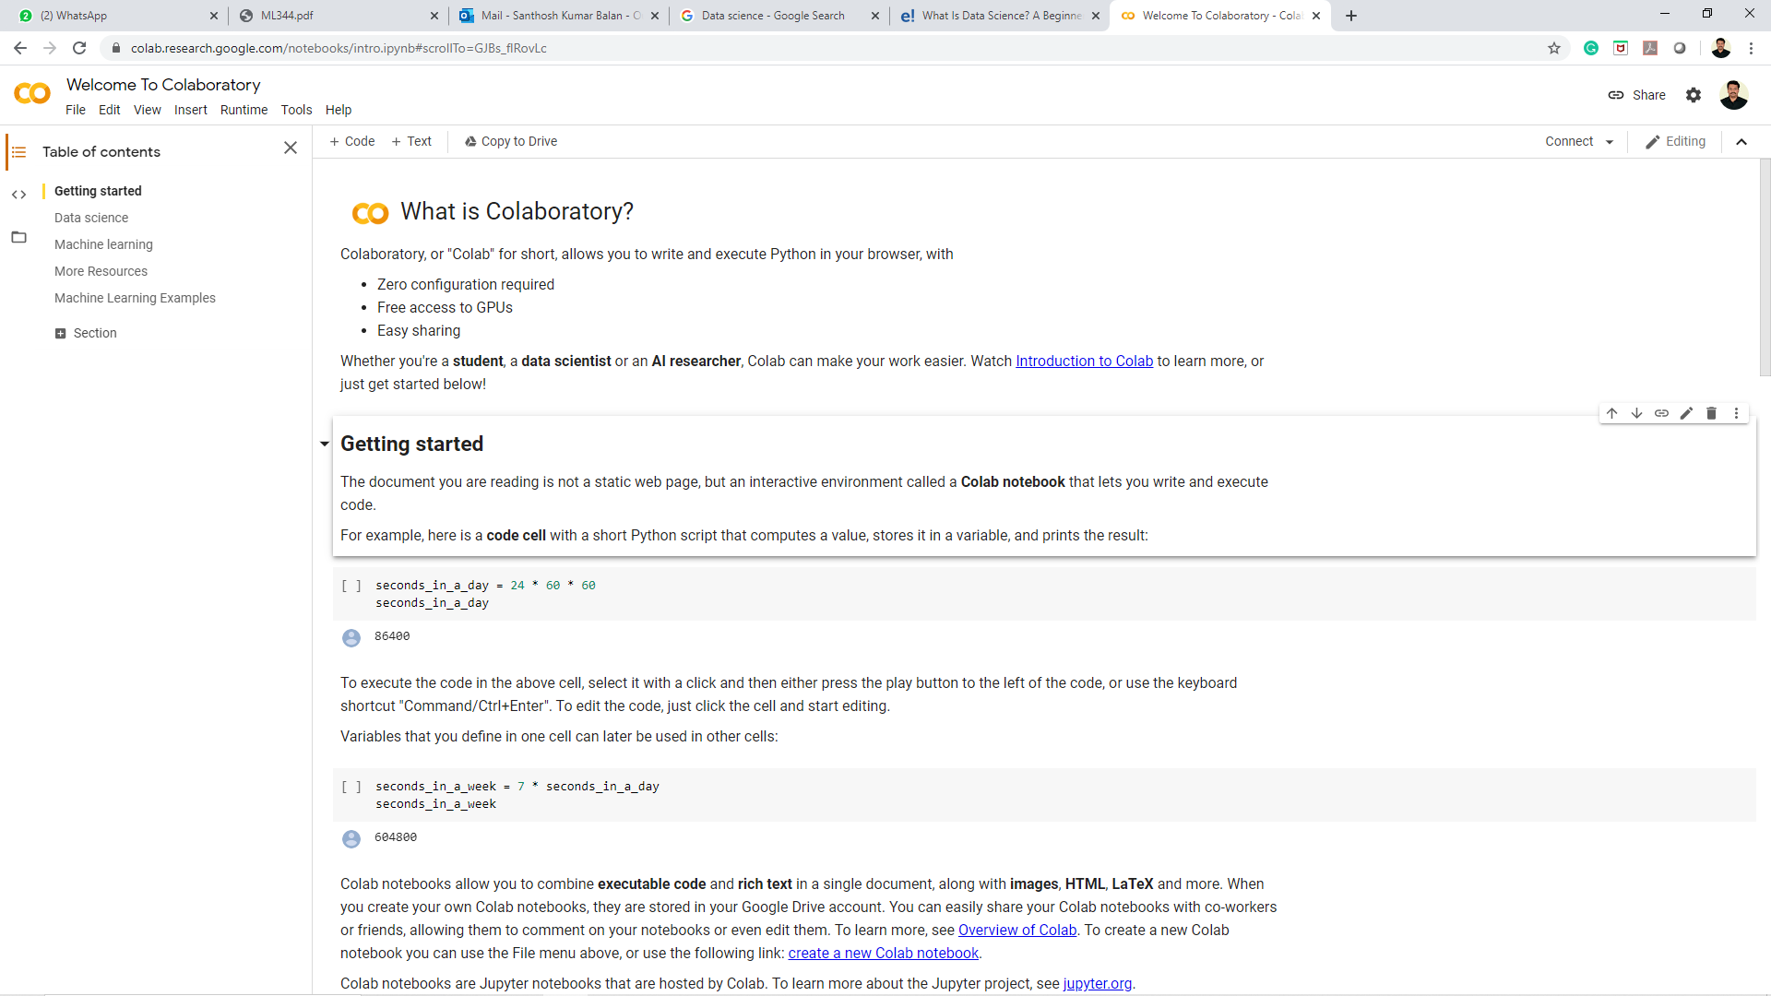
Google co-lab

Slide 25
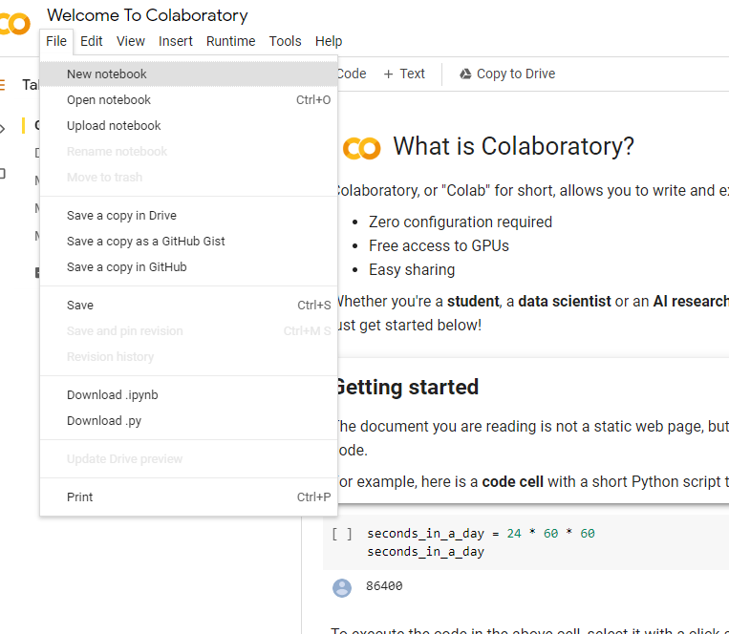
Google co-lab

Slide 26
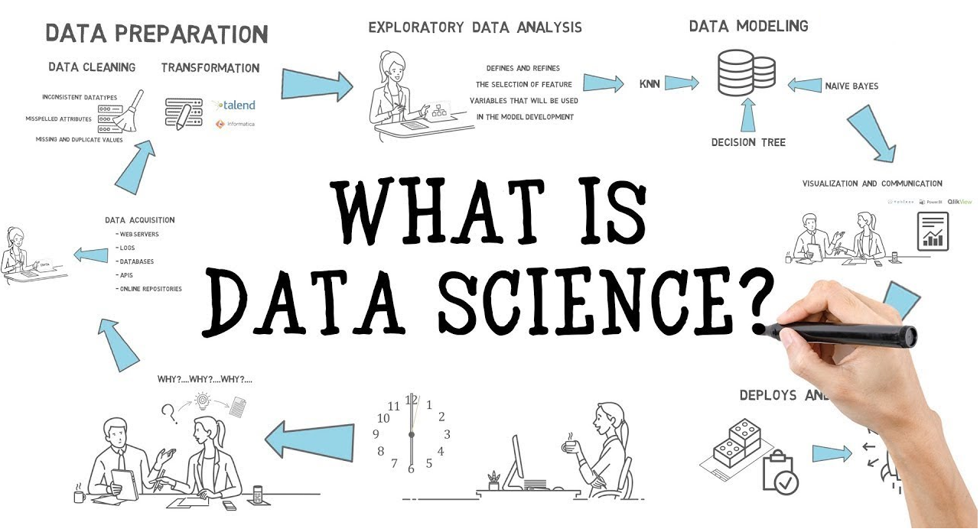

Slide 27
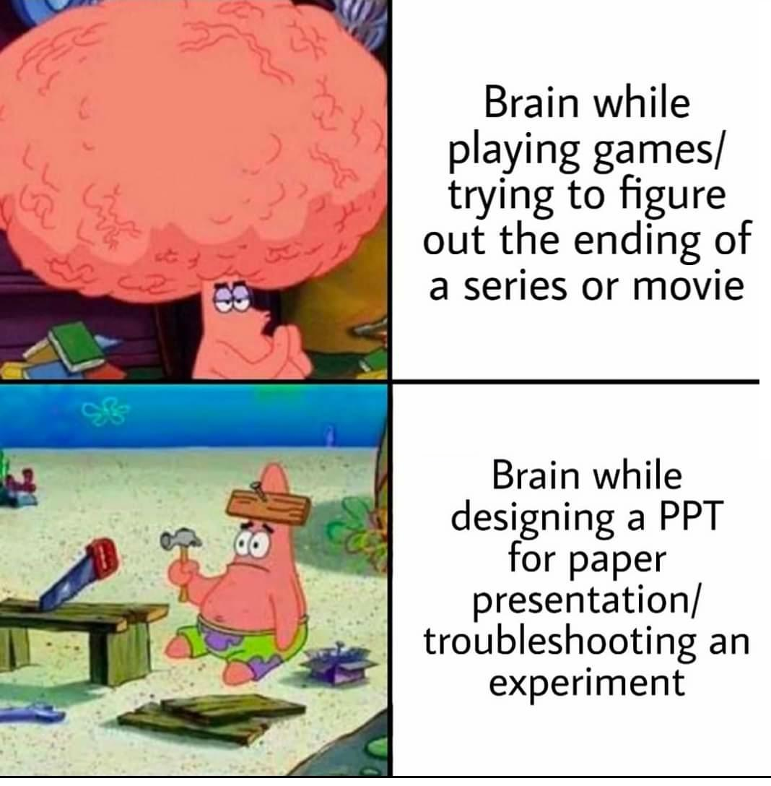

Slide 28
My Details
Mail-id : Santhosh.b@gmrit.edu.in
b.santhoshkumar@gmail.com
Contact No : 9843622130
Website : http://sanan.weebly.com
Research Blog:
https://gmrit.academia.edu/SANTHOSHKUMAR
http://scholar.google.co.in/citations?user=4NH2_aoAAAAJ&hl=en&authuser=1
https://www.linkedin.com/in/bsanthoshkumar80
http://orcid.org/0000-0003-1929-7337
https://in.vokipages.com/people/b-santhosh-kumar-5148307
http://www.researcherid.com/rid/N-3734-2016
https://www.researchgate.net/profile/Santhosh_Balan
https://www.mendeley.com/profiles/drsanthosh-kumar/

